Slide 1

Weather Prediction
Submitted by: Rahul Sisodia

Slide 2

Aim of the project
Using an ML Technique find out the factors having an impact on the Temperature.

Slide 3
Independent features & Dependent features
Independent features
Formatted Date
summary
Precip Type
Apparent Temperature
humidity
Wind speed
Wind Bearing
visibility
Loud Cover
pressure
Dependent features
Temperature

Slide 4
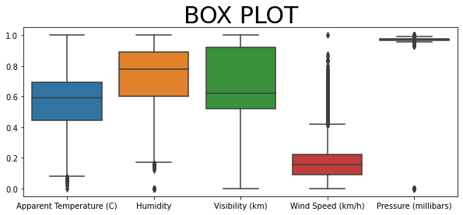
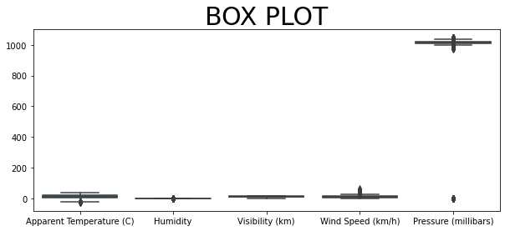
Year-wise Analysis
Above box plot is after the normalization
Below boxplot is before the normalization of data

Slide 5
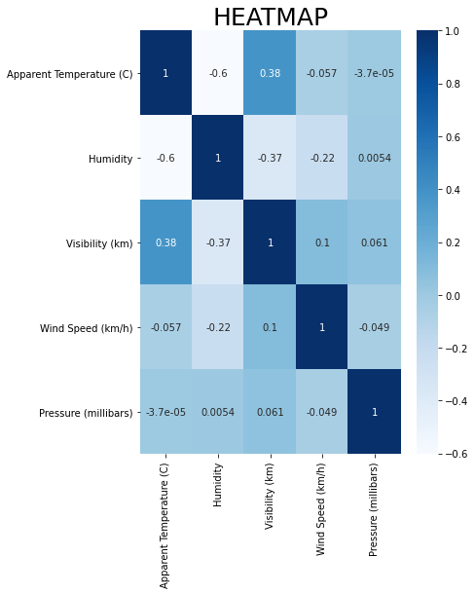
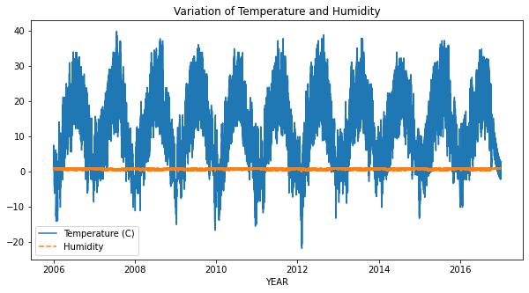
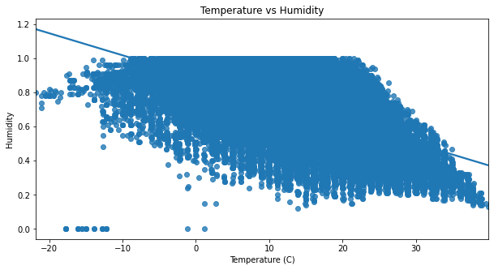
Correlation

Slide 6
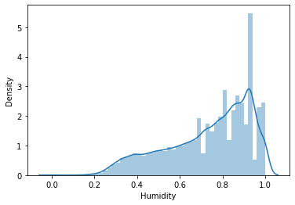
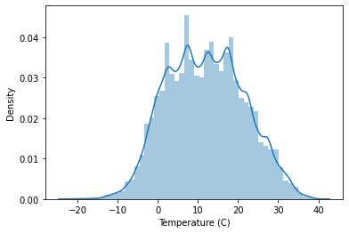
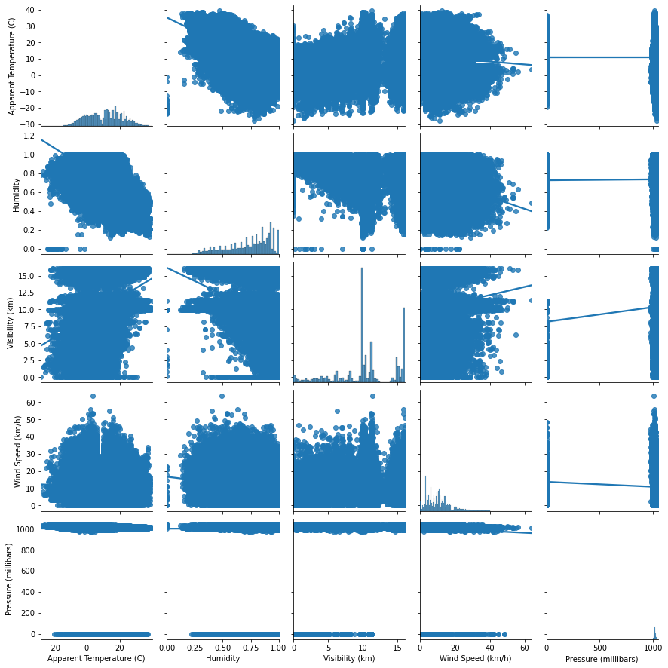
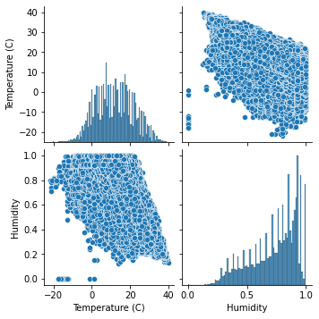
Univariate Analysis & Scatters plot

Slide 7
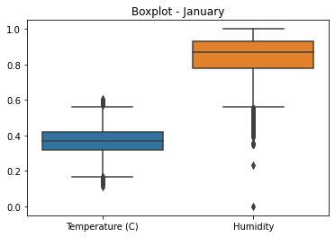
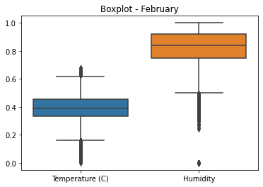
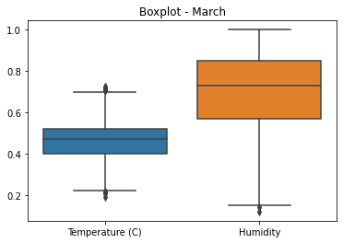
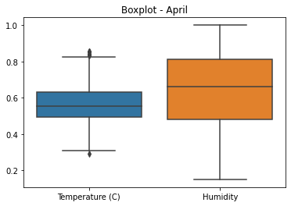
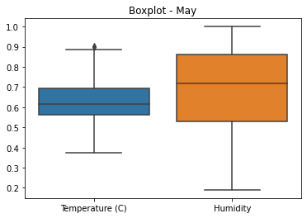
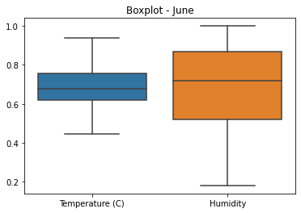
Bi-variate analysis Temperature vs Humidity

Slide 8
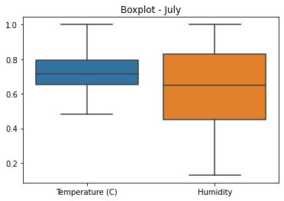
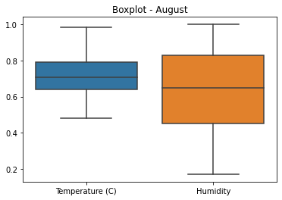
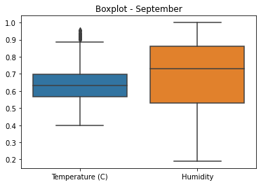
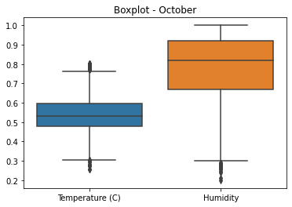
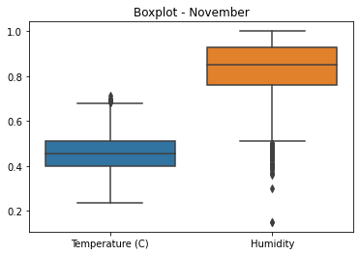
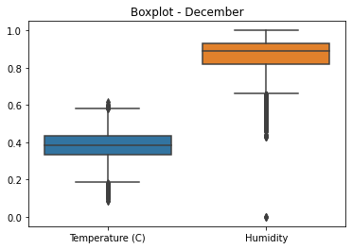
Bi-variate analysis Temperature vs Humidity

Slide 9
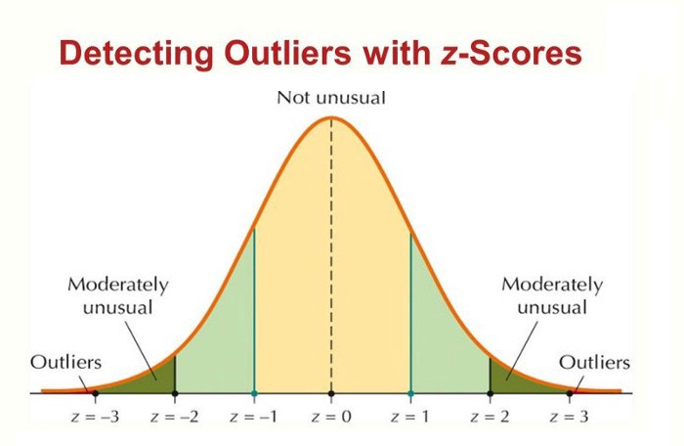
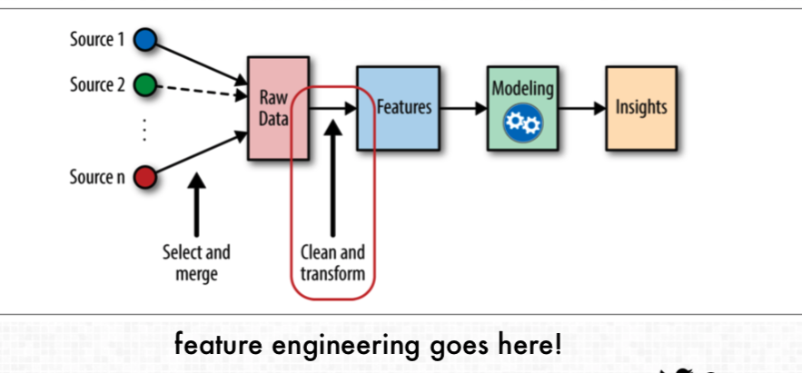
Feature Engineering Handling outliers, handling categorical features, features selection
Removed outliers from humidity
Handling categorical features
Nominal data --> data are not in any order --> One Hot Encoder is used in this case
Ordinal data --> data are in order --> Label Encoder is used in this case
Features selection Technique
heatmap
Feature importance
Select KBest

Slide 10
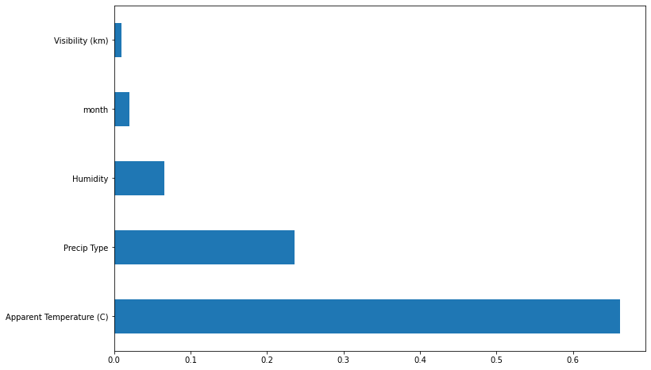
Important features
As we seen in this graph the apparent temperature is highly affect the depend features followed by precip type and humidity

Slide 11
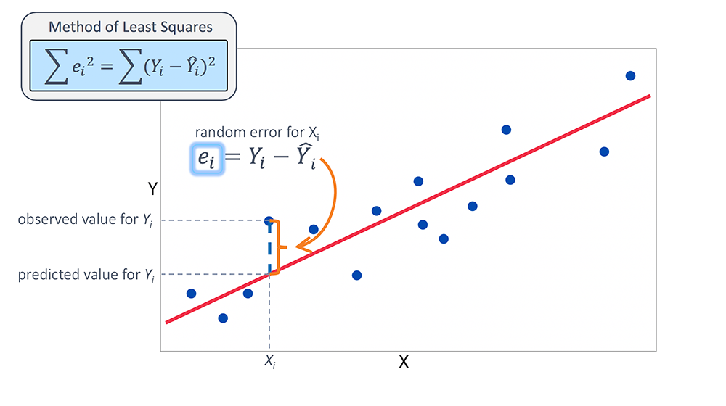
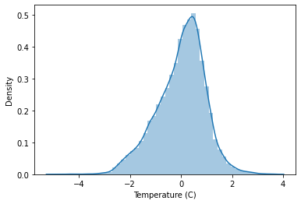
Model Building Linear Regression
Splitting the data into 70 % training and 30 % test
The Ordinary Least Squares procedure seeks to minimize the sum of the squared residuals.
Assumptions
The Relation between independent features and depended features should be linear
There shouldn’t be multicollinearity between independent features
Removal of outliers
Error should follow normal distribution
No autocorrelation

Slide 12
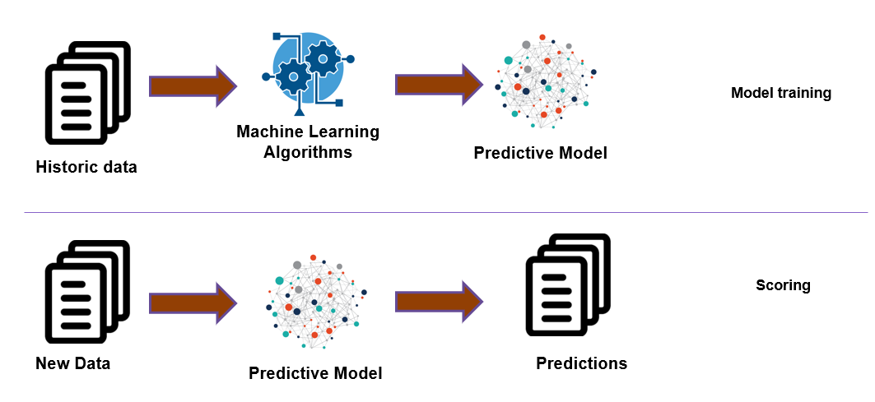
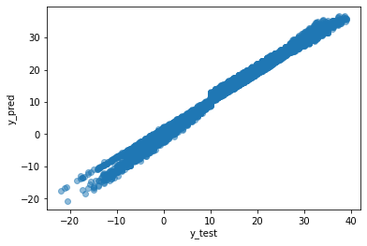
Model Evaluations
The accuracy of the model has come to 94%

Slide 13

Conclusion
We conclude that the temperature and humidity are inversely proportional to each other
Generally in winter season from November to February humidity is higher than temperature
In month of April may and June humidity and temperature was slightly differ
From month of July to September humidity is slightly lesser than temperature from October humidity start rising up.

Slide 14

Thank You

